Slide 1
Burnout and Workplace Well-Being for Community Health Workers
January 18, 2024

Slide 2

Acknowledgements
This product was supported by funds made available from CDC’s National Center for STLT Public Health Infrastructure and Workforce through cooperative agreement OT18-1802, Strengthening Public Health Systems and Services Through National Partnerships to Improve and Protect the Nation’s Health award # 6 NU38OT000317-04-01 CFDA 93.421. Its contents are solely the responsibility of ASTHO and do not necessarily represent the official views of the U.S. Department of Health and Human Services/CDC.
This product also draws on the work of numerous organizations and individuals deeply immersed in the work of defining and supporting community health workers. Their contributions are acknowledged via references throughout the deck.
Recording in progress
Notes:
Facilitation notes: Please include the acknowledgement as a part of this presentation; delete “Recording in progress” if you will not be recording or are facilitating an in-person session.

Slide 3
Purpose
Are you a community health worker (CHW), CHW supervisor, program manager, or clinic administrator seeking to 1) facilitate honest, reflective conversations about workforce burnout and support, and 2) take concrete actions that elevate CHWs and promote their well-being?
You’re in the right place. During this training, we will:
Lay out basic terms related to burnout and workplace well-being
Outline the complex factors that shape and influence burnout and workplace well-being
Identify steps various players can take to improve well-being in the workplace
This resource is intended as a general guide that may simplify complex matters for the purpose of discussion. Not every section may be exactly relevant to your work or context, but the general concepts and strategies are important in a variety of settings, for a wide range of actors. This presentation will be shared with you– feel free to adapt and use in your own workplaces to facilitate further conversation on these important topics.
Notes:
Facilitation notes: Please adapt to your setting based on your specific goals.

Slide 4

Other Goals for This Conversation
Reflect
Pause and think
Write down notes
Think about self and team members
Discuss
Take
Forward
Ask questions throughout
Share ideas and strategies if comfortable
Consider how to continue conversations
Learn more
First reflection: Why are you here today? Why did you choose to attend, and what do you want to get out of this?
Notes:
Facilitation notes: Set the stage for interaction and engagement by sharing these three key words: Reflect, Discuss, Take forward. Elaborate on each bullet point underneath, then pause.
Ask that everyone have a piece of paper and pen (or ideally, provide one to them).
Ask all attendees to take 2-3 minutes to think about the question on the bottom of the slide and write it down to keep front of mind.

Slide 5

First, Level-Setting: Who Are CHWs?
The American Public Health Association CHW Section has adopted the following definition of a community health worker:
CHWs are members of the community themselves and, as such, have expertise in the health issues affecting their communities and geographies.
A community health worker is a frontline public health worker who is a trusted member of and/or has an unusually close understanding of the community served. This trusting relationship enables the worker to serve as a liaison/link/intermediary between health/social services and the community to facilitate access to services and improve the quality and cultural competence of service delivery.
A community health worker also builds individual and community capacity by increasing health knowledge and self-sufficiency through a range of activities such as outreach, community education, informal counseling, social support, and advocacy.
https://www.apha.org/apha-communities/member-sections/community-health-workers
https://ucsdcommunityhealth.org/news/community-health-workers-training-program-aims-to-increase-access-to-health-care-services-in-underserved-neighborhoods/
Notes:
Facilitation notes: Ensure that all in attendance understand that we are referring to a workforce that can go by many names. Read the definition from APHA, noting that the important pieces are bolded in orange. Emphasize that CHWs are members of the communities where they work and bring unique knowledge and experiences.

Slide 6
CHWs may be employed under a variety of titles; however, they all face similar challenges that can lead to burnout.
Partial List of Titles for CHWs:
Community Health Worker (CHW)
Promotor(a) de Salud
Aunties
Birth Assistant (Doula)
Birthing Family Support Worker
Care Coordinator
Community Advocate
Community Aide
Community Care Specialist
Community Care Worker Community Coordinator
Community Dental Health Coordinators
Community Health Associate
Community Follow-Up Worker
Community Health Advocate
Community Health Aide
Community Health Coach
Community Health Coordinator
Community Health Educator (CHE)
Community Health Navigators
Community Health Organizer
Community Health Outreach Worker
Community Health Partners
Community Health Representative (CHR)
Community Health Specialist
Community Liaison
Community Navigator
Community Organizer
Community Outreach Navigator
Community Outreach Worker
Community Promoter
Community Social Worker
Cultural Case Manager
Cultural Interpreter
Cultural Mediator
Diabetes Education Associate
Diabetes Self-Management Support Associate
Diabetes Educator
Diabetes Family Support Worker
Diabetes Navigator
Family Advocate
Family Planning Counselor
Family Support Worker
Family Advocate
Family Health Advocate
Family Health Promoter
Family Outreach Worker (FOW)
Family Support Specialist
Family Support Worker
Health Ambassadors
Health Communicator
Health Extension Workers
Health/Nutrition Support Worker
Health Promoter
Health Liaison
Health Specialist
Health Workers
HIV/AIDS Educator
HIV/AIDS Family Support Worker
HIV Peer Advocate
Homeless Advocate
Lay Health Advocate
Lay Health Worker (LHW)
Mental Health Worker
Men’s Health Specialist
Men’s Health Worker
Navigator
Neighborhood Health Advocate
New Professionals
Outreach Advocate
Outreach Coordinator
Outreach Educator
Outreach Specialist
Outreach Worker
Patient Experts
Patient Navigator
Peer Advocate
Peer Counselor
Peer Educator
Peer Health Educator
Peer Support Specialist
Peer Wellness Specialist
Physical Activity Specialist
Social Determinants of Health Specialists
Street Outreach Worker
Wellness Ambassadors
Wellness Guide
Women’s Health Specialist
Youth Development Specialist
Youth Peer Counselor
Youth Worker
https://cachw.org/job-titles
Notes:
Facilitation notes: Emphasize that a variety of titles may fall under this umbrella. [before the session, you may also shade orange the terms commonly used in your jurisdiction]

Slide 7
Pause for Introductions
- Name, Location, Role
- What are CHWs called in your jurisdiction?
Notes:
Facilitation notes: Ask that everyone in the room introduce themselves (if they do not know one another) using the prompts above. If all present do know each other, consider asking another question and inviting each person to share their answer. This will serve to make individuals more comfortable speaking.

Slide 8

The Challenges CHWs Face as a Field
Lack of integration with other "health" partners: CHWs are often not formally connected to the rest of the public health system, including public health departments, primary care, and other less traditional "health" players including social service providers.
Variable compensation (often low or none): The compensation mechanisms for CHWs may be complex, and these positions are often time-limited, which contributes to reduced motivation for new professionals and difficulty retaining CHWs.
Perceived lack of standardization: Approaches to programming, training, and certification vary—this offers important flexibility for different contexts but also creates challenges for unified advocacy and awareness efforts.
Unclear career advancement pathways: "Advancement" often moves CHWs out of CHW-type roles, contributing to low retention and constant need for hiring and training.
Funding challenges: Programs are often funded by multiple grants of differing terms, which may be inflexible and short-term, restricting programmatic activities and staff development.
Common themes in these challenges include lack of respect and role standardization as well as insufficient or inconsistent coordination with other players in public health and medical systems.
Notes:
Facilitation notes: Use this slide to talk about why CHWs in particular are at high risk of burnout: they face challenges AS a field (current slide) and IN the field, as they work day to day. Briefly talk through these examples.

Slide 9
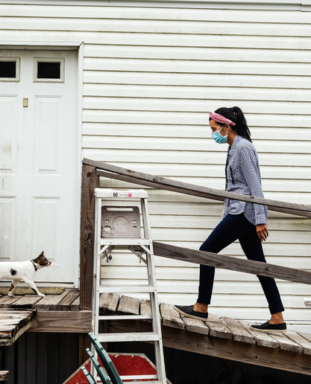
The Challenges CHWs Face in the Field
Access to transportation: CHWs often travel to remote communities to provide services or conduct outreach because the populations they serve often have limited access to transportation. CHWs should be reimbursed for traveling costs.
Safety issues: CHWs may deal with challenging interpersonal situations in communities and home visits. Programs must ensure the safety of CHWs and should provide safety training.
Program resources: CHWs often need access to technology, including mobile technology, to help them accomplish their jobs, especially in rural settings. Programs should provide the necessary resources and tools to complete their tasks.
Cultural barriers: CHWs serve a wide range of patients in their communities and are often able to bridge cultural barriers. To best support them in this effort, programs must provide materials that are culturally appropriate and communicate information in a way that considers local customs, beliefs, values, and traditions.
Patient referral challenges: CHWs often have difficulties referring patients to healthcare providers and coordinating services with outside providers. Steps should be taken to improve systems for coordination of care between agencies.
Partnership challenges: Limited partnership with public health, social service, and private organizations can limit outreach or unintentionally duplicate activities. Programs should identify opportunities to work with new and existing partner organizations to help extend the reach of a CHW program.
Which of these are most significant in your settings?
Notes:
Facilitation notes: Talk through these examples as well. After you have introduced them, click again to reveal the question: “Which of these are most significant in your (or our) setting?”. Invite attendees to share.

Slide 10
Topics
Background on Burnout
What Is Workplace Well-Being?
Levels of the Environment/System
Structural Level
Organizational Level
Interpersonal Level
Individual Level
Summary & Key Takeaways, Additional Resources
Notes:
Facilitation notes: “So with that background in mind, let’s talk about burning and workplace wellbeing.”

Slide 11
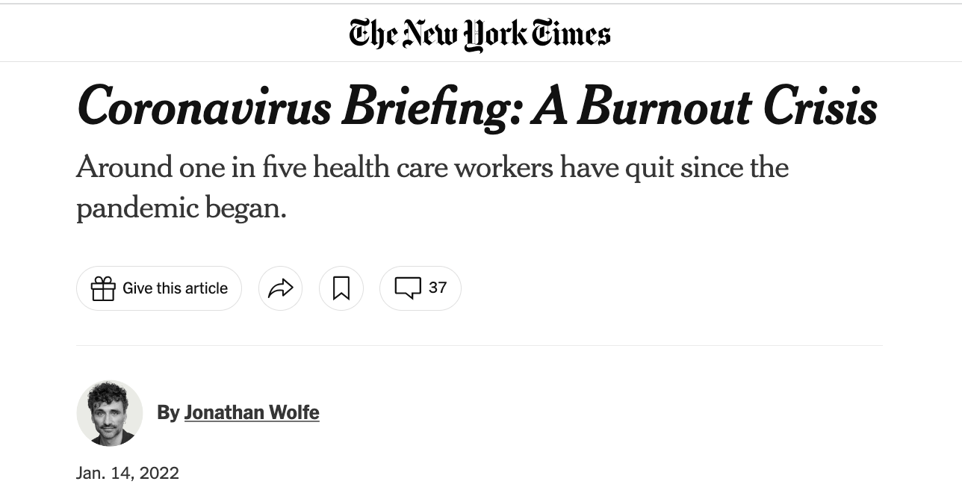
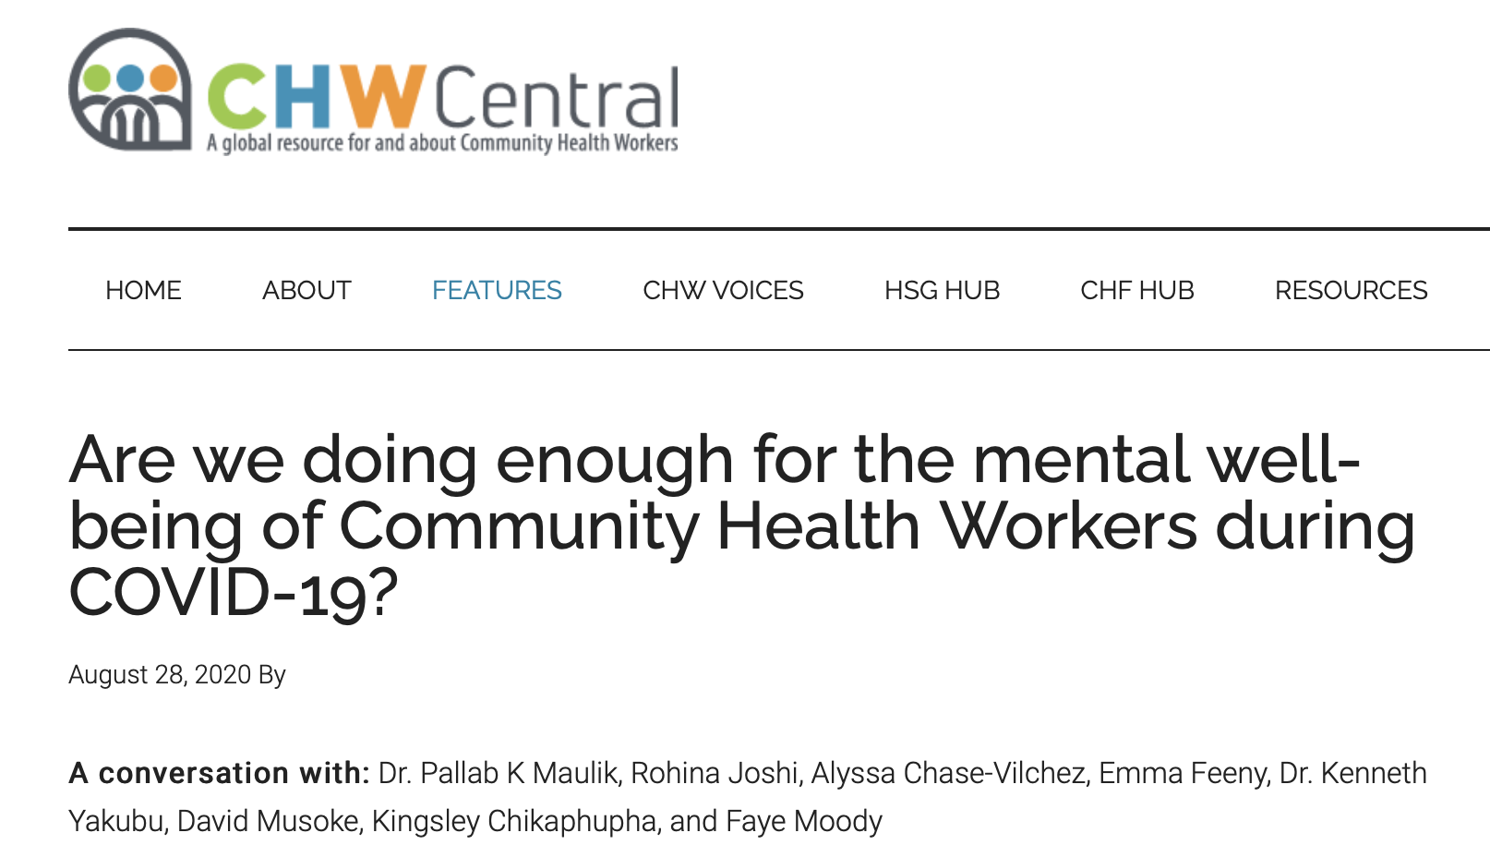
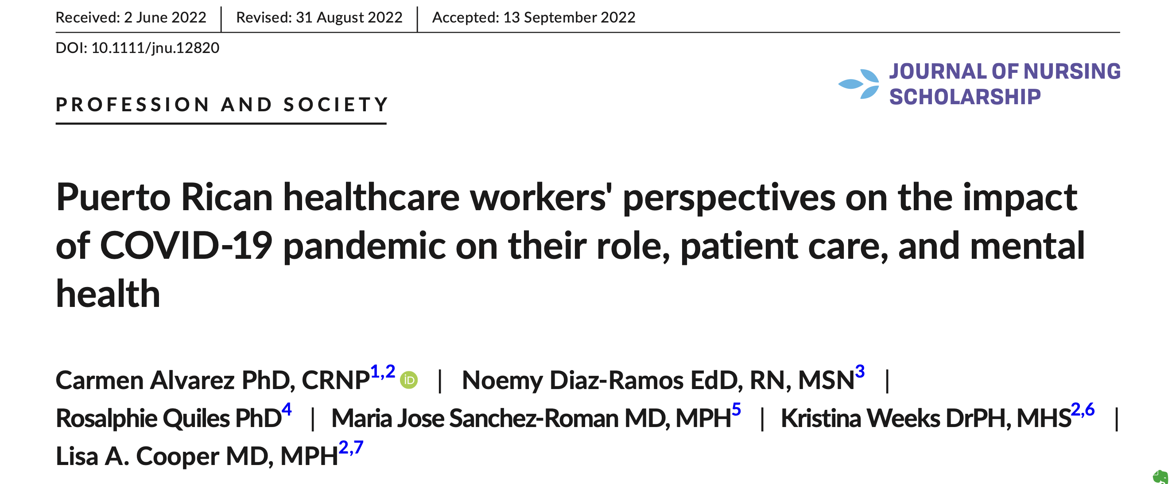
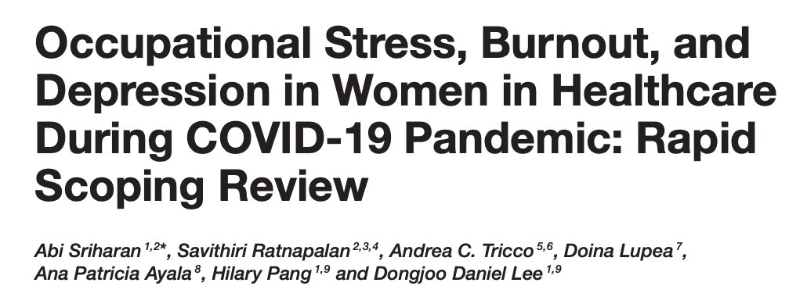
A Burnout Crisis Amidst a Global Pandemic
"Workforce burnout" soared during the pandemic, particularly among healthcare workers, as individuals faced overload, trauma, and lack of protection and support. But burnout is not a new phenomenon, and it hasn't gone away since the crisis faded.
Headlines about this additional crisis are prevalent, and numerous studies are emerging from around the world documenting the pandemic’s effects on the health workforce.
Notes:
Facilitation notes: Burnout was a huge topic during the pandemic throughout the public health and health workforce. This is a small sample of the headlines many of us saw. But burnout was not new then, and it hasn’t gone away.

Slide 12

What Is Burnout?
Burnout is the emotional exhaustion that results in decreased sense of personal accomplishment at work, sometimes accompanied by the feeling that you're observing yourself from outside your body or that things around you aren't real (called "depersonalization").
CHWs and Burnout
CHWs have a unique role in the health care system. They are intimately involved in the lives of their patients, generating a rewarding sense of purpose and meaning.
But this powerful role also brings with it unique risks, as CHWs witness and work to address complex physical, psychological, and social needs. CHWs may experience "compassion fatigue" because of their involvement in the lives of patients, some of whom have intense emotional pain as a part of their lived experience.
CHWs are at high risk of burnout.
https://healthleadsusa.org/communications-center/resources/battling-burnout-self-care-and-organizational-tools-to-increase-community-health-worker-retention-and-satisfaction/
Notes:
Facilitation notes: Offer this definition for burnout, highlighting emotional exhaustion and depersonalization. Emphasize again why CHWs are at high risk: they walk alongside clients and communities and navigate difficult physical, emotional and psychosocial needs.

Slide 13
Why Does Burnout Matter?
For health workers
Insomnia, heart disease
For patients/clients
Delays in care
For the healthcare system broadly
Workforce shortages
For communities and society
Eroded trust
Isolation, substance use, depression
Relationship challenges
Exhaustion
Lower quality care
Limited services and low access
Worse outcomes
Increased disparities
There is a range of negative consequences of health worker burnout, on multiple levels:
“Our health depends on the well-being of our health workforce.” – U.S. Surgeon General
Notes:
Facilitation notes: Note the implications of burnout across the entire health value chain. There are physical and psychosocial effects for the individuals themselves. There are additional consequences for patients or clients. There are others for the healthcare system, and for communities/society. Read this quote from the US Surgeon General.

Slide 14

What Can We Do to Address Burnout?
Too many resources focus on self-care as the solution to burnout.
Self-care (discussed later in this resource) has an important place in the workplace, but it is not a solution to the complex and multifaceted layers of burnout, and it places sole responsibility on CHWs.
Preventing and addressing CHW burnout requires dedicated commitment and action at a range of levels, by a variety of partners.
This session strives to share practical steps that CHWs, supervisors, employers, and communities can all take to do their part to promote workplace well-being and ensure CHWs are fulfilled and supported to play their important roles for years to come.
Notes:
Facilitation notes: State that ”We know this is a big, complex challenge and that change takes time, but there are steps we can all take. We all have a role to play. Too often, we focus on self-care as the solution, but this is not a problem that can be solved by an individual CHW. We’re having this conversation to find some practical steps we can all take as [mention roles present] to promote the health and wellbeing of our community health workforce.”

Slide 15


Before We Continue
Take a moment to think back on your own professional experiences.
Have you ever felt emotionally exhausted? What were the specific stressors at that time?
How did it impact your life outside of work?
It can be difficult to break apart feelings of burnout and identify where we may be able to take action to prevent or address it.
Creative commons: Scorched Earth
This Photo by Unknown Author is licensed under CC BY-NC-ND
Notes:
Facilitation notes: On this slide, ask for people to pause and reflect, writing down their thoughts. Read the questions on the slide and give 5 minutes to independently think. Then, invite individuals to share. You may ask for a volunteer or call on someone, depending on comfort level.
Before moving to next slide: “It can be difficult to break apart feelings of burnout and identify where we may be able to take action to prevent or address it. In the next section we’re going to talk about one tool/framework that can help us to really pull apart the many things that may be contributing to burnout.”

Slide 16
Topics
Background on Burnout
What Is Workplace Well-Being?
Levels of the Environment/System
Structural Level
Organizational Level
Interpersonal Level
Individual Level
Summary & Key Takeaways, Additional Resources
Notes:
Transition slide

Slide 17
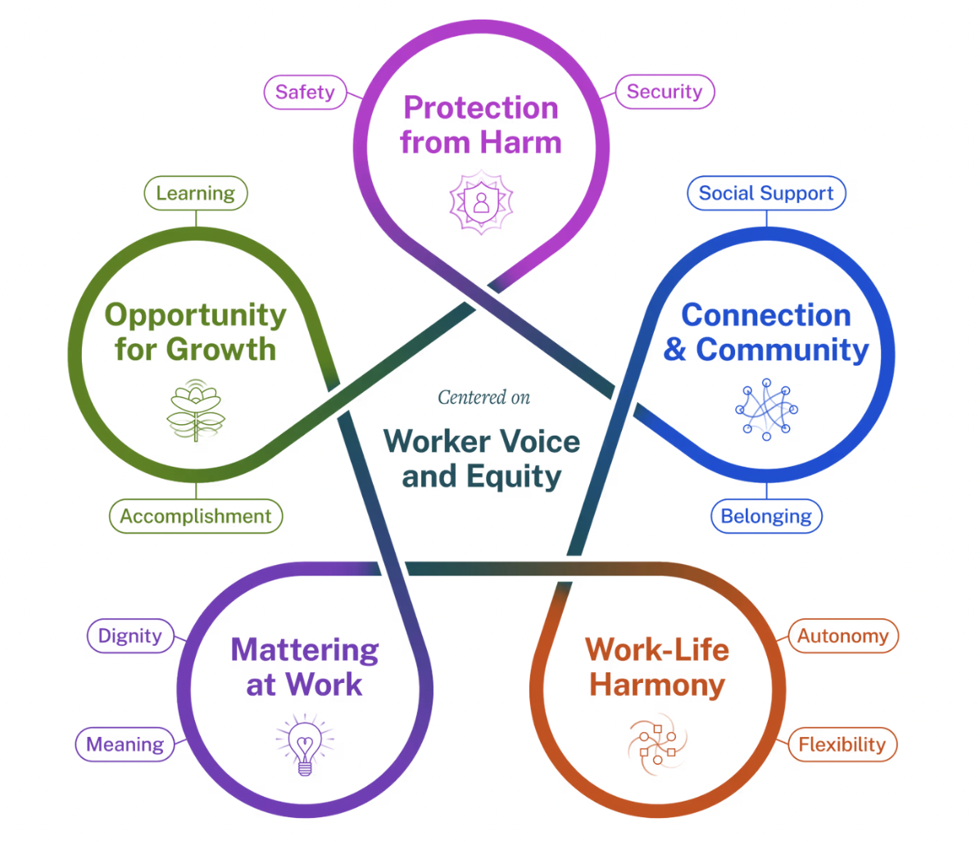
Workplace Well-Being: A Useful Framework to Understand and Address Burnout
The U.S. Surgeon General’s “Principles of Workplace Well-Being” provide a framework for understanding and addressing burnout, and more broadly for promoting well-being.
Centered on the worker’s voice and equity, the framework names "Five Essentials" to help workplaces work as engines for well-being. Each essential is connected to two human needs that must be understood and met for holistic workplace well-being.
The Five Essentials (+ Human Needs):
Protection from Harm (safety and security)
Connection & Community (social support and belonging)
Work-Life Harmony (autonomy and flexibility)
Mattering at Work (dignity and meaning)
Opportunity for Growth (learning and accomplishment)
https://www.hhs.gov/surgeongeneral/priorities/workplace-well-being/index.html
Notes:
Facilitation notes: The US Surgeon General, recognizing widespread burnout in various workforces after the pandemic, released this framework for workplace wellbeing. While it’s complex, it is widely applicable to a range of roles and helps to separate some of the complex factors that determine our health and wellness.
Centered on the worker’s voice and equity, the framework names "Five Essentials" to help workplaces work as engines for well-being. Each essential is connected to two human needs that must be understood and met for holistic workplace wellbeing. [Read through each of the five essentials and corresponding needs, offering examples from your context as needed to clarify meaning].
We know that we will always face challenges, but this can help us dissect them and diagnose where we or our team members may be struggling. We’ll talk through each of these in the context of CHWs soon.

Slide 18
Take a Moment to Reflect
Review the Five Essentials and Their Associated Basic Needs:
Where do you (or where do your team members) seem to be very comfortable or supported?
Where do you see challenges?
Write these reflections down; we’ll revisit in later sections.
https://www.hhs.gov/surgeongeneral/priorities/workplace-well-being/index.html
Notes:
Facilitation notes: before we talk about each of these in context of CHWs, let’s take a moment to process and make sure we understand this. [Read the questions and ask that people write them down. After 3-5 minutes, ask for someone to share*. Invite others as well, before moving to the next slide.
*Note that you should be aware of power dynamics in this conversation. For example, if you are a supervisor leading the training, CHWs may hesitate to share a challenge related to your supervision. Do not force anyone to share, and acknowledge your openness to feedback in this space and elsewhere.

Slide 19
Topics
Background on Burnout
What Is Workplace Well-Being?
Levels of the Environment/System
Structural Level
Organizational Level
Interpersonal Level
Individual Level
Summary & Key Takeaways, Additional Resources
Notes:
Transition slide

Slide 20
Further Discussions: The Complexity of Burnout and Well-Being.
The five essentials and corresponding needs are complex, and there are many aspects that are outside the control of CHWs.
Remember, workplace well-being requires multiple people to do their part across different levels of the environment/system.
Notes:
Facilitation notes: This is a complicated graphic, and that’s appropriate – because we are complicated, and our wellness is influenced by a lot of factors, some that are within our own control and others that are not. I’m going to introduce one more visual to help us talk about this aspect of locus of control – whose responsibility are some of these things. What can CHWs control, what can supervisors or managers support and ensure, and what needs action at other levels entirely.

Slide 21
What Do We Mean by Levels?
Structural
Organizational
Individual
Interpersonal
Consider how workplace well-being, like so much in our lives, is shaped by factors at multiple levels of the environment/system.
Structural Level: societal systems, policies, and social forces
Organizational Level: institutional polices, culture, and practices
Interpersonal Level: relational interactions
Individual Level: habits, behaviors
Notes:
Facilitation notes: The visual I share now relates to levels. Where does the responsibility and capability for action lie? Many of you may be familiar with the socioecological model that helps us think through layers of a system or structure for where things are rooted and where action needs to happen. Starting at the bottom, individual level - habits and behaviors. Moving up to interpersonal – relational interactions with other people. The organizational level refers to institutional polices, culture, and practices. The structural level refers to the societal systems, policies, and social forces.

Slide 22
Revisit Your Last Reflection
Structural
Organizational
Individual
Interpersonal
Review the Essentials that seemed like challenge areas and pick one that feels most important/critical.
Think about factors at each of these levels that create this challenge.
Now, think about what needs to happen at each of these levels to overcome that challenge.
In the next section, we’ll revisit these levels to identify opportunities for improvement and intervention to better support the CHW workforce.
Notes:
Facilitation notes: Ask that people return to their reflection sheet and think about the challenges they wrote down. Pick one “Essential” that feels like the biggest or most important challenge and think about factors at each of this levels that create this challenge. Now, think about what needs to happen to overcome the challenges.
Give up to 10 minutes for individual reflection. You may also consider putting people in small groups to discuss, if desired. Ask for volunteers to share.
Close with the last line of the slide. Consider taking a short break here.

Slide 23
Topics
Background on Burnout
What Is Workplace Well-Being?
Levels of the Environment/System (quick stretch break!)
Structural Level
Organizational Level
Interpersonal Level
Individual Level
Summary & Key Takeaways, Additional Resources
Notes:
Transition slide

Slide 24
Recall from the Previous Section
Structural
Organizational
Individual
Interpersonal
Workplace well-being, like so much in our lives, is shaped by forces at multiple levels and requires actions at multiple levels.
  Structural: societal systems, policies, and social forces
  Organizational: institutional polices, culture,
  and practices
  Interpersonal: relational interactions
  Individual: self habits, behaviors
We’ll now look at each of these in more detail.
Notes:
Facilitation notes: Spend little time on this slide. Just note that we’re going to look at each of these in the context of CHWs’ work.

Slide 25
Structural Factors Related to Burnout: What Are They?
Structural
Organizational
Individual
Interpersonal
Structural factors: Racism, gender discrimination and violence, income inequality, and more.
They are the policies, systems, institutions, and social forces that generate and maintain the conditions that produce hierarchies and inequalities.
“The water we swim in”: These factors determine basic quality of life and shape our realities even when we don’t consciously recognize them.
Our safety and security are heavily influenced by structural factors.
Notes:
Facilitation notes: Starting with structural. Read this slide – but feel free to adapt to your context with framing that better speaks to your audience.

Slide 26
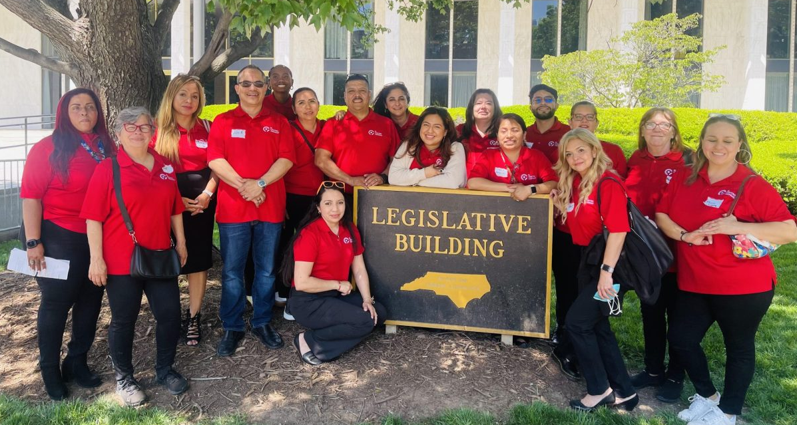
Structural Factors: What Can Be Done?
While structural factors are among the most important for well-being, they are often ignored in discussions of well-being, burnout, and self-care because they might feel too difficult to change. They require political solutions, and sometimes these solutions remain in the control and power of far-away governments.
However, organized and mobilized grassroots movements for change are powerful ways to transform structural factors, and becoming actively involved in such movements can itself improve mental health and well-being. On the right is an example of how one CHW organization joined the grassroots movement.
Are there other ways you might be able to influence structural change?
El Centro community health workers/promotores de salud visit the NC General Assembly to advocate for funding. Credit: Rubi Morales
Spotlight: Legislative Advocacy in North Carolina
El Centro Hispano is an organization that recruits, trains, and manages promotores de salud in Durham, NC. El Centro team members visits the NC General Assembly three times every month to continue to advocate for increased funding for this critical community health workforce.
https://shelterforce.org/2017/11/22/how-organizing-for-justice-helps-your-mental-health/
Notes:
Facilitation notes: Read first paragraph. Structural change can happen via the long-term work of jurisdictions and civil society organizations to advocate for more funding and better support.
Note that getting involved in movements at the local level can be a helpful way to work towards systems change, depending on your role. Read example at right; invite any additional examples from attendees.

Slide 27
Organizational Factors Related to Burnout: What Are They?
Structural
Organizational
Individual
Interpersonal
Organizational factors: Institutional policies and practices that lead to...
  Work overload
  Lack of care team integration
  Lack of proper supervision
  Lack of consistent training
Reviewing policies, practices, and program design with respect to the above issues can help you identify opportunities to improve support for CHWs.
Examples of Supports
What supports and benefits are in place for CHWs?
Is there a pathway to promotion?
Do CHWs get adequate time off?
Notes:
Facilitation notes: Let’s move now to organizational factors. There are a lot, but Ill go into more detail on 4 because there are some really strong examples in the CHW space of changing organizational factors for the better. This can start by reviewing policies, practices and program design to look at things like:
- What supports and benefits are in place for CHWs?
- Is there a pathway to promotion?
- Do CHWs get adequate time off?

Slide 28
Organizational Factor: Work Overload
Work overload triples the risk of burnout.
It subjects CHWs to psychological, social, and spiritual injury, also known as “moral injury,” by forcing CHWs to choose between their patients and themselves.
It leads to reduced flexibility, autonomy, time to learn and progress, and time to share and connect with others.
Organizational Actions to Reduce Work Overload:
Ensure all team members are aware of the CHW job description, which should include a set number of tasks.
Systematize routine aspects of the job (such as screening processes) to help streamline and save time.
Critically evaluate staffing: Is there more work than the current team should take on?
Find ways to track evidence of overwork and burnout.
Highlighted Resources
It is an important role of supervisors to carefully protect CHW time. There are numerous tools and resources available to equip supervisors to effectively support and protect CHWs.
MHP Salud’s “Six Tips for CHW Supervision Success” and Supervision Manual
The National Academy of Medicine’s “Supervision Strategies and Community Health Worker Effectiveness in Health Care Settings”
https://healthleadsusa.org/communications-center/resources/battling-burnout-self-care-and-organizational-tools-to-increase-community-health-worker-retention-and-satisfaction/
Notes:
Facilitation notes: The first factors we’ll look at is work overload. [read items in the arrow shape, then read the possible actions]. Note that supervisors play a critical role and that there are some great resources available to better equip supervisors to serve as advocates for their teams and watch for signs of overload.
Ask attendees: Anyone have different strategies or approaches they have used to prevent or manage overload?

Slide 29

Organizational Factor: Lack of Care Team Integration
Lack of team integration contributes to reduced sense of belonging, dignity, meaning, and autonomy.
CHWs need to be recognized for their unique role and as part of a larger health team, rather than just serving as an extension of or substitute for other health professional roles.
Organizational Actions to Help Integrate the Care Team:
Ensure ways for CHWs to share expertise and influence decisions made on care delivery and organizational practice.
  Supervisors: Ask CHWs to present patient and community updates in meetings and workgroups.
Find ways to increase CHW visibility and power within the organization.
  Encourage CHWs to keep reflection logs to promote processing and story sharing. However, it is critical to ensure there is a balance of effort, so that the process alleviates rather than increases work burden.
Spotlight: Improving Care Team Integration
In Benton County, OR, CHWs participate in daily care team huddles, where they contribute to shared understanding of patients’ health statuses, needs, and goals.
Photo credit to the Massachusetts Association of CHWs (MACHW) – read more about their integration efforts here
https://healthleadsusa.org/communications-center/resources/battling-burnout-self-care-and-organizational-tools-to-increase-community-health-worker-retention-and-satisfaction/
Notes:
Facilitation notes: Next, lack of care team integration (or programmatic team integration!) You can naturally see how this reduces sense of belonging, dignity, meaning, autonomy.
It’s so important to feel like you’re part of a team. [Read text in arrow, and actions in gray box beside it. Share example from Benton country (or replace with your own). Invite others to share examples of how they’ve worked to prevent or manage workload for teams.]

Slide 30
Organizational Factor: Supervision
Supervision is a critical part of CHW training and ongoing work, promoting skill development, supporting problem solving, and increasing motivation and engagement, among other things.
Effective supervision enhances CHWs' abilities, promotes quality care, and contributes to better health outcomes within the communities they serve.
Organizations: Pay attention to supervisor/leadership trainings and ongoing skills development. Clinical expertise and experience do not automatically translate into supervisory skills.
Encourage supervisors to:
  Have regular check-ins with CHWs and encourage open, honest communication.
  Protect CHW boundaries, guarding against overload, “underload,” or underappreciation.
Cultivate a supportive work environment where challenges are raised and discussed, and where CHWs feel supported.
Spotlight: Supportive Supervision
“Practicing supportive supervision with community health workers is a mutual process where both the supervisor and the CHW have an opportunity to grow, change, and learn. Engaging in this process with CHWs has been one of the supreme joys of my career.” — Noelle Wiggins, Community Health Worker Supervisor and CHW Common Indicators Project*
*Note: “Supportive and Reflective Supervision” has been identified by the Project as an important indicator of program functioning
Notes:
Facilitation notes: Coming back to supportive supervision. This is critical and underrecognized, but we all know how much a difference a supportive supervisor can make in our wellbeing. [read text in arrow, then in gray box. Note that effective supervision is a critical indicator of program success, as named by the CHW Common Indicators Project].
Side note – supporting CHWs to eventually step into supervisor roles helps with another of the essentials of wellbeing – accomplishment. And it helps ground in real experience.

Slide 31
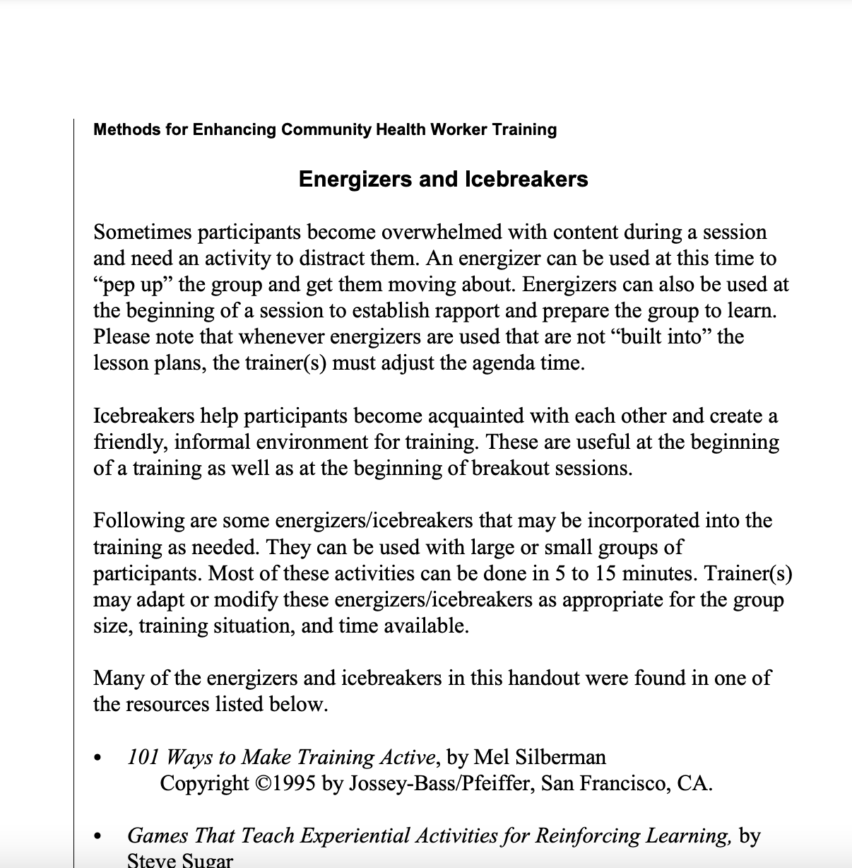
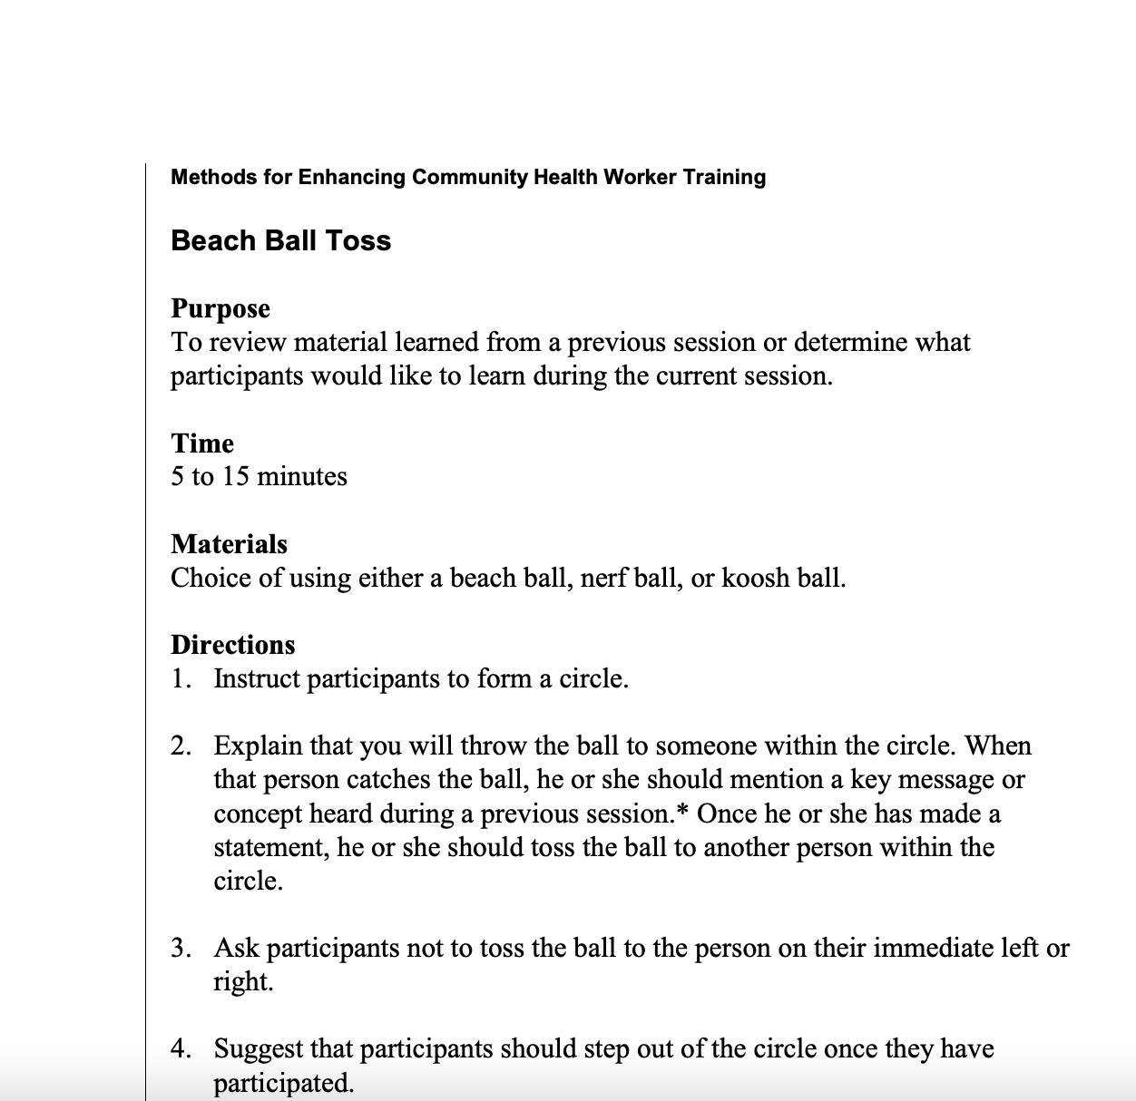
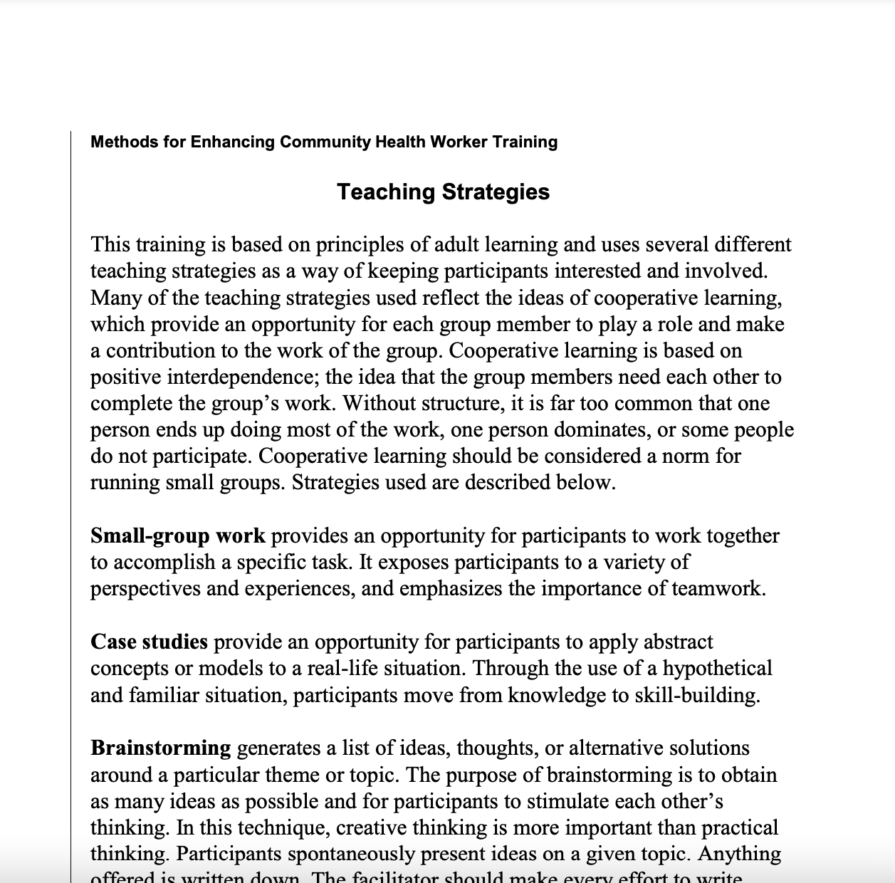
Organizational Factor: Training
Comprehensive and well-designed training has a profound impact on CHWs’ ability to stay safe, deliver high-quality services, establish trust, and contribute to improved health outcomes.
Training is not a one-time occurrence and requires attention to content as well as methods to promote knowledge retention and skill building.
Training improves connection and autonomy; instills sense of accomplishment and growth.
Initial trainings should include knowledge-based and health promotion components as well as build core CHW strengths in relationship-building and social interaction (often called “soft skills”).
  Include time for teambuilding and connection with peers, ensuring trainings are interactive and participatory.
Organize education days for team bonding, learning, case discussions.
Cultivate opportunities for growth and skill development.
Ensure protected time for learning and skill building after initial training.
Highlighted Resource: Enhancing Training
Training is an art and a skill. High-quality training can equip CHWs to be more comfortable and confident in day-to-day work. There are numerous resources and courses available on ways to make learning interactive, participatory, collaborative, and fun. This resource from CHW Central, initially developed by CDC, is full of ideas that can be quickly implemented for lasting impact.
https://chwcentral.org/wp-content/uploads/2013/09/tp-section1_1.pdf
Notes:
Facilitation notes: Finally, training. It’s a big topic, and it can feel like an immense amount of work. But it’s important to so many of the essentials. [Read the text in the arrow, highlighting the aspects in bold as you speak. Read the actions in the gray box].
Note that the tool provided has some great ideas for making training fun and engaging but there are many others out there. Invite individuals to share their best experience in a training. Why was it so great?

Slide 32
Interpersonal Factors Related to Burnout: What Are They?
Structural, Environmental, Policy
Organizational
Individual
Interpersonal
Interpersonal factors: Increasing human interactions and strengthening relationships
Relationships and social connections are key to managing adversity, stress, and day-to-day well-being. Our safety, dignity, and meaning are all shaped and enabled through our relationships.
Organizations and supervisors play a role in structuring spaces for interpersonal connection as a way of working, but individual CHWs can also cultivate connections.
Notes:
Facilitation notes: Moving to our next level, the interpersonal. How can we increase interactions and strengthen relationships? Some of this relates back to organizational responsibilities to support connection and build it into the way of working, and to supervision, but there are also things that CHWs themselves can do.

Slide 33
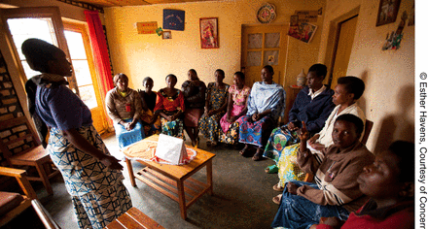

Interpersonal Factors: What Can We Do to Support Strong Relationships?
Supervisors and Organizations:
  Organize peer support groups to ensure a workplace forum for bonding and support.
  Ensure confidential emotional support outlets for CHWs to discuss relationship stressors or isolation.
  Organize regular team huddles and informal gatherings.
CHWs:
  Connect with one another, recognizing your peer relationships as a critical tool in your work and well-being.
  Pay attention to changes in your colleagues and signs of burnout or increased stress.
Spotlight: Interpersonal Connections
The Kabeho Mwana Project, operated from 2006-2011 in Rwanda, formed small peer support groups (PSGs) among CHWs working in case managers of child illness and health promotion. The PSGs supported problem solving and building of social capital; ultimately, the project saw improvements in performance, supervision, and motivation as well as care-seeking among catchment populations (Langston et al, 2014)
How does your workplace support interpersonal connection?
The Bahomwana CHW Peer Support Group meets in Gasambu village, Rwanda, to exchange ideas and challenges in order to accomplish and improve their work.
Notes:
Facilitation notes: Note some of the things that supervisors and organizations can do to promote connection, and some of the things that individual CHWs can so. Read through the example, and ask for attendees to share anything else that they or others have done to promote connection.

Slide 34
Individual Factors Related to Burnout: What Are They?
Structural, Environmental, Policy
Organizational
Individual
Interpersonal
Individual factors: Actions, habits, behaviors
As in any job, there are steps individuals can take to balance their work with their lives and to stay physically and mentally healthy.
However, we must re-emphasize that while self-care is crucial, it should not obscure the fact that most drivers of burnout are outside of CHWs’ direct control.
Self-care cannot change workplace conditions or structural factors.
Notes:
Facilitation notes: Last but not least, we come to individual factors. As I said before, self-care is NOT the solution. BUT it is a part of the puzzle, and there is some great stuff out there. For all of us, and for the people we support, we out it to ourselves to understand the principles of self-care and uphold them in our work together.

Slide 35
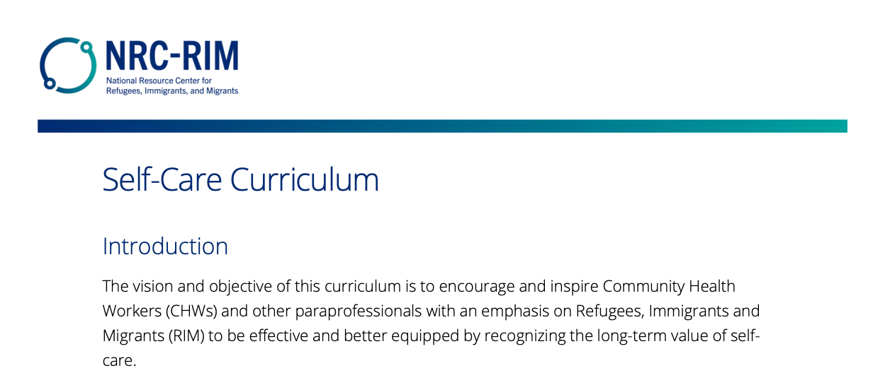

Individual Factors: What Can We Do to Take Care of Ourselves?
Spotlight: Self-Care
Self-care is “the practice of caring for your physical, emotional, and psychological well-being” and requires you to be aware of your own needs.
Pay attention to what contributes to your own burnout and emotional disconnection from work.
Key components include healthy eating, exercise, quality sleep, strengthening social connections, mindfulness, and avoiding stress.
There are a range of resources freely available to promote CHW self-care. Our favorite is this self-care curriculum developed by the National Resource Center for Refugees, Immigrants, and Migrants and CHW Solutions.
Available in English and Spanish, it provides an overview of self-care along with useful tools and frameworks that CHWs can work through together or independently.
How do you take care of yourself each day?
Supervisors, do you encourage team members to pay attention to self-care?
https://nrcrim.org/self-care-community-health-workers
https://chwtraining.org/wp-content/uploads/2019/04/CHWTrainingBurnoutPrevention2019-04-19.pdf
Notes:
Facilitation notes: [Read the definition of self care and the other bullets, noting what’s often included in a self-care plan. Highlight the range of resources out there, including this great one from NRC-RIM – take a look if you haven’t yet! Ask people how they take care of themselves. What recharges them, what do they need to feel balanced? How do supervisors make space for self-care?]

Slide 36
Topics
Background on Burnout
What Is Workplace Well-Being?
Levels of the Environment/System
Structural Level
Organizational Level
Interpersonal Level
Individual Level
Summary & Key Takeaways, Additional Resources
Notes:
Transition slide

Slide 37
Summary & Key Takeaways
Burnout is one of the most significant threats to workplace well-being.
The drivers of burnout occur at structural, organizational, interpersonal, and individual levels of the environment/system.
While individual efforts (i.e., self-care) are important, coordinated efforts at the organizational level are also critical to prevent and address burnout.
We hope this is the start of more conversations and actions as we work together to improve workforce wellness.
What Now?
There’s no quick solution or easy fix to burnout in the workplace. However, there are things we can all do, regardless of our roles, to better position our workplaces as sources of well-being and to pay more attention to our energy and needs.
Reflect back on the information covered and commit:
What is one action I can take today to promote my own well-being?
What is one way I can support those around me to do the same?
What is something that will require wider partnership to enact, and what is my next step to start that process?
Notes:
Facilitation notes: [Read through the summary and key takeaways. Then turn to the “What now” box. Ask everyone to reflect back on their notes from today and answer the 3 questions (3 minutes to think). Invite each person to share a response to one or all of these.]
Close by thanking attendees and sharing your commitment to continue these conversations and be of support to others seeking to take action. Note the resources available on the next slide.

Slide 38
Additional Resources/Reference Materials
Resource | Source | Description/Purpose
Framework for Workplace Well-being | U.S. Surgeon General’s Office (HHS) | Framework to understand and improve well-being in the workplace, generally
Self-care for Community Health Workers | National Resource Center for Refugees, Immigrants, and Migrants (NRC-RIM) | Interactive training for CHWs available in English and Spanish (online & PDF versions)
Burnout Prevention & Recovery for CHWs | CHWTraining & Happiness 1st Institute | Training deck with burnout self-test, mood resources
Development and implementation of a Pacific Island‐Centred COVID‐19 Health Worker Safety Guide | Pacific Emergency Education | Developed a Health Worker Safety Guide for Australia and New Zealand COVID‐19 – addresses the safety aspect of well-being
Battling burnout: Self-care and organizational tools to increase community health worker retention and satisfaction | HealthLeads | Overview of CHW risk factors for burnout + select organizational approaches to preventing and addressing it
Professional Quality of Life Inventories & Self-Care Handouts | ProQOL | Offers a series of self-assessments in multiple languages to evaluate burnout, compassion fatigue and satisfaction, moral distress, and perceived support, as well as self-care tools and recommendations
Addressing Health Worker Burnout | US Surgeon General’s Office (HHS) | Webpage and report on burnout in the health workforce and suggested action for multiple stakeholders
Secondary Traumatic Stress & Burnout for CHWs | Arizona State University | Includes link to a CHW assessment and other supportive resources
Boundaries as self-care: How caregivers (like CHWs) avoid burnout | Health Care Access Now | Self-care tips for caregivers

Slide 39
Thank You!
For any questions about this resource or technical assistance needs, please contact ASTHO Island Support: islandsupport@astho.org
Photo by Lynsey Weatherspoon for PIH

