Slide 1
Facilitation Slides: Using Health Equity Indicators to Guide Community Health Improvement in the U.S. Territories and Freely Associated States
[Date]
Notes:
Facilitation notes: The purpose of these slides is to support Island Area Public Health Agencies as they work through this process of conceptualizing and measuring health equity in teams and community settings. Slides include steps and examples directly from the ASTHO Guide, “Using Health Equity Indicators to Guide Community Health Improvement in Island Areas.”

Slide 2

Purpose of Guide
Are you a public health agency staff member or partner from an island area seeking to achieve health equity using data?
The Using Health Equity Indicators to Guide Community Health Improvement in the U.S. Territories and Freely Associated States serves as a roadmap for island areas public health agencies to establish a shared understanding of health equity, identify and develop health equity indicators and measures, and track progress on health equity efforts.
Notes:
Facilitation notes: Read the slide content. Adapt the slides to meet the needs of your public health agency and community served.
The Guide includes a series of steps and considerations for island area public health agencies, including tips on engaging community partners in the overall process. To help provide a new perspective this Guide offers direction on how to identify and use health equity indicators to shape performance improvement in island areas.

Slide 3
How to Use the Guide
Complement existing efforts of island areas public health agencies to collect data with the goal of understanding and addressing health inequities, health disparities, and social and structural determinants of health that impact communities and populations.
Use alongside community members and local partners.
Leverage expertise from collaborative efforts between island areas public health agencies and the communities and populations they serve.
Recognize that community members are experts on their needs and priorities.
Notes:
Facilitator notes: Read slide content. Adapt the guide to island and community context. Consider how to use the guide to support island areas public health agencies efforts to understand and achieve health equity using indicators and measures.

Slide 4
[Using Health Equity Indicators to Guide Community Health Improvement in the U.S. Territories and Freely Associated States]
Notes:
Facilitation notes: Read content below. Modify title of this slide as needed to fit your community context.
These slides were designed to supplement the ASTHO Guide, “Using Health Equity Indicators to Guide Community Health Improvement in U.S. Territories and Freely Associated States.” The Guide includes a series of steps and considerations for island area public health agencies, including tips on engaging community partners in the overall process. Let's discuss this presentation now to learn more.

Slide 5

Overview
Monitoring progress toward health equity involves measuring health equity and inequities, health disparities, and social and structural determinants of health, as well as tools to facilitate the interpretation of these data.
Health equity metrics, including indicators and measures, play an integral role in helping to establish and sustain a culture of equity.
These slides align with the steps in the Guide and serve as a training to support conversations around measuring health equity in island areas. Slides may be adapted to reflect the local community and context. They may be especially helpful when working in collaboration with public health agencies, organizational partners, and the community.
Notes:
Facilitation notes: Read slide content and then content below.
The U.S. Territories and Freely Associated States—collectively referred to as the Island Areas or Island Jurisdictions— face a unique and shared set of challenges and strengths, including the availability of resources, geographic isolation, cultural traditions, resilience, and emphasis on community well-being. While the interplay of multiple factors shape tracking advancements in health equity, as the Island Areas begin to define their mission, vision, and achieve health equity efforts, health equity metrics, including indicators and measures, play an integral role in helping to establish and sustain a culture of equity, guided by ongoing engagement of public health agencies, partners, and communities to continually address the needs of communities and populations disproportionately impacted.

Slide 6
Goals of the Training
  During this training, we will learn about the following:
  How to build shared understanding for health equity.
  How to communicate health equity concepts to staff, partners, and community members.
  How to identify and develop health equity indicators and measures.
  How to monitor progress toward health equity and identify opportunities for improvement.
Notes:
Facilitation notes: Read slide content. Pause between each bullet point. Please adapt to your setting based on your specific goals.

Slide 7
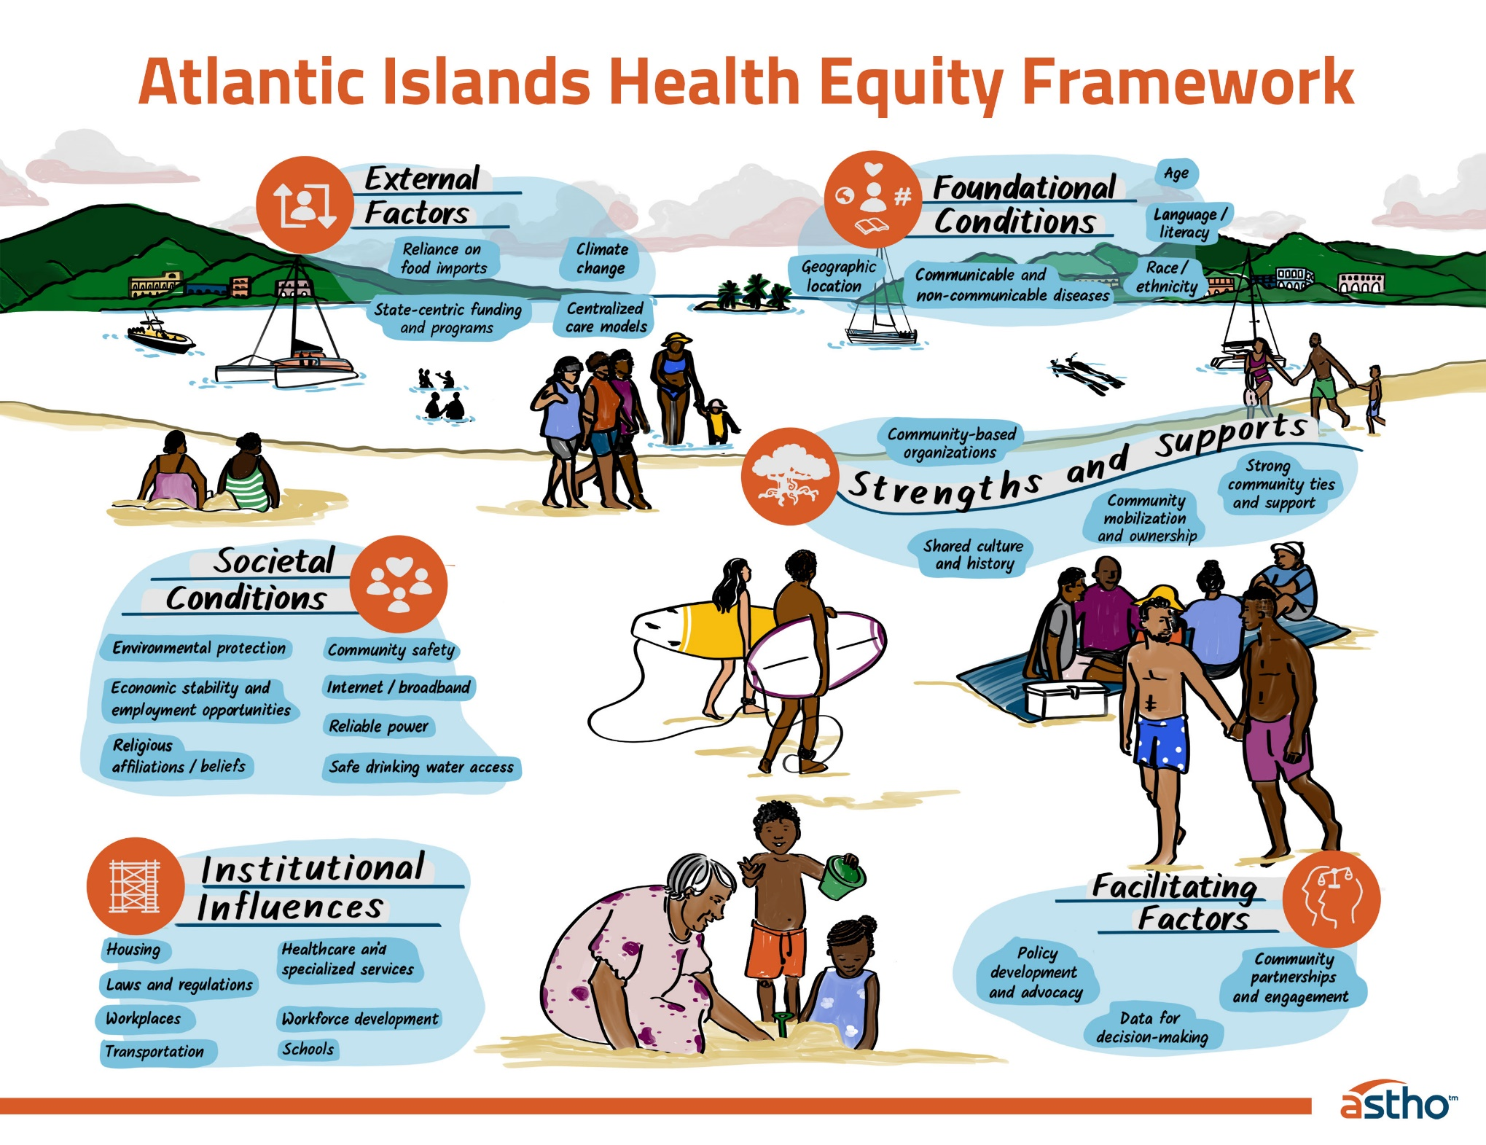
Atlantic Islands Health Equity Framework
ASTHO’s Islands Health Equity Framework is visualized in this graphic:
Creates a shared understanding of how to move toward health equity in an island context.
Builds on current health equity frameworks to authentically reflect the culture, experiences, and strengths of island communities.
To learn more, visit: https://www.astho.org/topic/territories-freely-associated-states/island-equity-framework/.
Notes:
Facilitation notes: Keep this slide if presenting to Atlantic Islands, remove if presenting to Pacific Islands. Read content below.
These efforts align with ASTHO's Islands Health Equity Framework, developed with input from island health agency leaders, to help build the foundation for health equity and how to move towards health equity in an island context. Specifically, examples of indicators that align with key areas of the ASTHO's Islands Health Equity Framework are included.
The purpose of ASTHO’s Islands Health Equity Framework is to create a shared understanding of how to move towards health equity in an island context. The starting point of this framework—visualized in these graphics—builds on and recontextualizes current health equity frameworks to reflect the culture, experiences, and strengths of island communities more authentically.

Slide 8
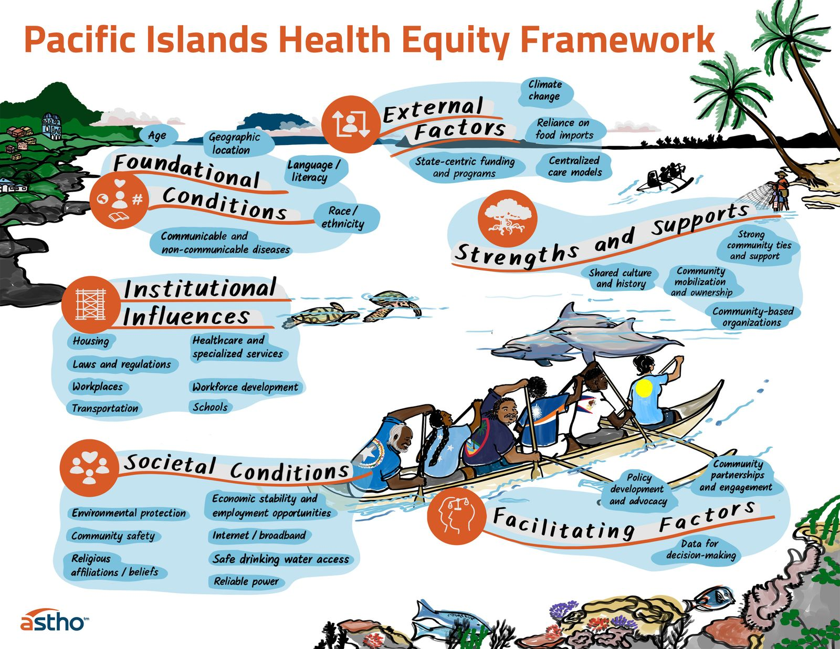
Pacific Islands Health Equity Framework
ASTHO’s Islands Health Equity Framework is visualized in this graphic:
Creates a shared understanding of how to move towards health equity in an island context
Builds on and recontextualizes current health equity frameworks to authentically reflect the culture, experiences, and strengths of island communities.
To learn more, visit: https://www.astho.org/topic/territories-freely-associated-states/island-equity-framework/.
Notes:
Facilitation notes: Keep this slide if presenting to Pacific Islands, remove if presenting to Atlantic Islands. Read content below.
These efforts align with ASTHO's Islands Health Equity Framework, developed with input from island health agency leaders, to help build the foundation for health equity and how to move towards health equity in an island context. Specifically, examples of indicators that align with key areas of the ASTHO's Islands Health Equity Framework are included.
The purpose of ASTHO’s Islands Health Equity Framework is to create a shared understanding of how to move towards health equity in an island context. The starting point of this framework—visualized in these graphics—builds on and recontextualizes current health equity frameworks to reflect the culture, experiences, and strengths of island communities more authentically.

Slide 9
Steps to Action
Six Steps
Collaboration
Monitor Progress
Six steps outline actions to identify and develop health equity indicators to find opportunities for improvement and track progress on efforts to achieve health equity.
Work through these steps in collaboration with island areas public health agency staff, practitioners, and community experts to advance local action.
Consider how each step stimulates monitoring and sustaining advancements in health equity.
Notes:
Facilitation notes: Read the content below.
Now we would like to touch on the Steps to Action to support establishing a shared understanding of health equity, to identify and develop health equity indicators and measures, and to track progress on health equity efforts.
The following six steps outline actions that can be taken to establish a shared foundation to achieve health equity and identify and develop health equity metrics using local and representative data.
The metrics, including indicators and measures, can be used to explore opportunities for improvement and track progress on efforts to achieve health equity. To achieve health equity in island areas public health agencies should work through these steps in collaboration with staﬀ, practitioners, and community experts to advance local action.
Consider how each one of these steps promotes achieving health equity. Consider how each one of these steps promotes monitoring and sustaining advancements in health equity.

Slide 10

Steps
1
Build Shared Understanding
2
Frame Health Equity
Identify and Develop Indicators Through a Health Equity Lens
3
Use Storytelling and Data to Achieve Health Equity
4
Embed Health Equity Indicators in Plans
5
Revisit and Scale Up Plan for Measuring Health Equity
6
Notes:
Facilitation notes: Set the stage for a deeper dive into the steps by sharing this overview of the six steps. Read each one, pausing between.

Slide 11
Step One
Build Shared Understanding
Notes:
Facilitation notes: Read content below. Use this step to build shared understanding of health equity as it applies to the island/community context.
The first step is to identify opportunities for improvement and track progress on efforts to achieve health equity is to build a shared understanding.

Slide 12

Step One
Achieving health equity requires building a common understanding of concepts and language to help advance efforts and collaborative action to improve health and well-being for all.
Notes:
Facilitation notes: Read slide content and then content below.
By creating a shared understanding of how health equity is defined in island area contexts, public health agencies will be better equipped to guide the measurement of health equity, as well as direct resources to the intended purposes.

Slide 13
Step One: Build Shared Understanding
Build the concept of health equity within public health agencies.
  Consider the following questions:
    What is health equity?
    What does an ideal state of health equity mean for the island areas public health agency and community?
    Who are programs and services (e.g., schools, health systems, public health, housing, transportation) reaching versus not reaching?
    How are interventions distributed across social factors of concern (e.g., income, geography, education)?
Notes:
Facilitation notes: Read the slide content and then the information below.
Build the concept of health equity within public health agencies.
Build understanding through ongoing structured dialogue, agency-wide training, and peer learning.
Assess current efforts and identify where health inequities can be further explored.
Discuss what it means to achieve health equity, including developing a clear definition. Consider the questions outlined on the slide and share examples from the island context/community to discuss.

Slide 14
Step One: Build Shared Understanding
2. Engage island areas public health partners to help facilitate discussions.
  Identify island areas public health partners to engage and help facilitate discussions with public health agencies to build the foundation.
Engage the community.
  Consider the following questions:
    Do they feel their knowledge of their community is important?
    Has their voice been heard to identify their needs or thoughts?
    Do they feel like a valued partner in the efforts to address health equity?
    Has the community voice been part of the conversation to identify the needs of their community?
Notes:
Facilitator notes: Read slide content and then information below.
2. Engage Island Areas public health partners to help facilitate discussions.
Identify Island Areas public health partners to engage and help facilitate discussions with public health agencies to build the foundation.
Consider experts such as the Pacific Island Health Officers Association, the Centers for Disease Control and Prevention, or community health centers.
3. Engage the community.
Gather a wide range of perspectives to ensure that a shared definition of health equity will resonate with diverse community members, recognizing they are the true experts in their communities.
Work with communities, hospitals, and all people to explore the ideal picture of health equity.
Developing a shared vision for health equity may help reflect on the structural and systemic factors contributing to health inequities.
Communities may find common ground in defining health equity in terms of core values and opportunity.

Slide 15
Step Two
Frame Health Equity
Notes:
Facilitation notes: Read content below. Use this step to emphasize why framing health equity is important.
Addressing health equity requires reframing the conversation to resonate with the community members, partners, and other Island Areas collaborators.

Slide 16

Step Two
Frame issues in a way that resonates with community members, partners, and other island areas collaborators.
Notes:
Facilitation notes: Read slide content and then content below. Frame conversation around what it means to achieve health equity.
Leverage data to change the narrative of what creates health and well-being.
Reframing helps focus communication on the underlying drivers of inequities and deepen understanding of the factors that impact health outcomes.
As efforts begin to develop health equity indicators, reframing will help to identify the most important indicators for measuring health equity in the community.
Reframing will help to identify the most important indicators for measuring health equity in the community.

Slide 17
Step Two: Frame Health Equity
Focus on health equity rather than health disparities.
  Reframe public health communication efforts that focus on health equity rather than health disparities.
    For example: Consider infant immunization rates. The percent of mothers with higher education by geography (outer islands versus main islands): Are the geographic differences in immunization rates attributable to education level? This reframing not only explores the differences in health status between population groups but also the differences in the distribution of resources between groups.
Frame health equity as achievable.
  Break down health equity into manageable concepts when solutions are offered across multiple levels.
Notes:
Facilitation notes: Read the content below.
Focus on health equity rather than health disparities.
This reframing outlines a pathway to address health disparities in a meaningful, non-stigmatizing, and sustainable way and outlines how to meaningfully examine data. Reframing equity is important when you clearly understand disparities, have data to describe them, and can frame them in terms of equity.
Facilitation notes: Read slide content in orange and briefly talk through this example. Include alternative examples that apply to the island/community context. Once complete, read the content below.
Frame health equity as achievable.
Use action terms to show pathways to address disparities and avoid language that speaks to a false belief that nothing can be done to change health outcomes.

Slide 18
Step Two: Frame Health Equity
3. Communicate to address stigma.
  Consider how public health agency programs and services are engaging these communities.
    For example: Talk about health challenges as just another part of life that affects most people at some point, like many physical health issues.
4. Meet the community where they are.
  Engage community members and partners to discuss the impact of health inequities.
  Discuss what health equity means to them and what it looks like in their community or context.
    For example: Consider external factors that are controlled or strongly influenced by institutions and governments outside of the Island Areas that affect the health of communities.
Notes:
Facilitator notes: Review the slides and the notes below.
3. Communicate to Address Stigma.
When communicating with, about, or for Island Areas communities who are disproportionately impacted by health inequities, such as LGBTQI+, migrant, and outer island populations, consider the unique needs and barriers these communities face, including language, discrimination, stigma, and rejection.
Craft communication to help reduce perceptions of stigma.
4. Meet the community where they are. Consider what is needed to meet the community served where they are.
Engage community members and partners who represent these populations to discuss the impact of health inequities and understand what supports the community needs to address inequities.
Identify populations or groups who are not showing up to receive public health services (e.g., immunizations, screenings).
Engage community members and partners to understand what supports the community needs to address inequities, including data.

Slide 19
Step Two: Frame Health Equity
5. Communicate health equity as a “we” issue.
  Build on the island areas shared values, culture, traditions, and interconnectedness, and help the communities you serve see themselves as impacted by inequities.
    For example: Work with states and territories to help build CHW models.
Build public health agency staff capacity to understand health equity.
  Engage public health agency staff to help build capacity to understand and achieve health equity.
  Use a health equity lens.
    For example: Consider, Who is affected/impacted? Who benefits, and who is harmed? What does the data tell us? What values underlie the decision-making process?
Notes:
Facilitator notes: Read through the notes on the slide below. Adapt the content to the local island context/community.
Communicate health equity as a "we" issue.
Share examples of how equitable approaches can benefit all, such as using the Community Health Worker (CHW) model to bridge the gap between public health agencies and communities served to address access to services.
6. Build public health agency staff capacity to understand health equity.
Engage public health agency staff, such as those not trained in health equity and data science, to help build capacity to understand and achieve health equity.
Build capacity through staff orientation and training to help set the stage for a shared understanding. Outline the main concepts of health equity and how it applies to agency programs and services, including how data plays a role in community health improvement.
Use a health equity lens - Bring focus to the impact policies and practices have on shaping economic, social, and built environments.

Slide 20
Step Three
Identify and Develop Indicators Through a Health Equity Lens
Notes:
Facilitation notes: Read the slide content and then the content below. Use this step to explore how to identify and develop indicators through a health equity lens.
Indicators are used to measure health equity and reflect a variety of factors that promote or harm health and well-being in populations and communities
Local knowledge and context are essential to both defining and measuring health equity, especially in the Island Areas with diverse geographies, cultures, economies, and resources.

Slide 21

Step Three
A health equity lens can be used to explore equity within existing datasets and across indicators.
This approach involves looking deeper at each indicator and examining differences in outcomes between populations or communities with different levels of access to resources, privilege, and power.
Notes:
Facilitation notes: Read content below and then slide content. Include examples of how health equity is measured in the local island/community context.
Health equity can be measured in multiple ways, including measures of health disparities, inequities, and social and structural determinants of health. It can also be measured by exploring existing health indicators and by developing new indicators.

Slide 22
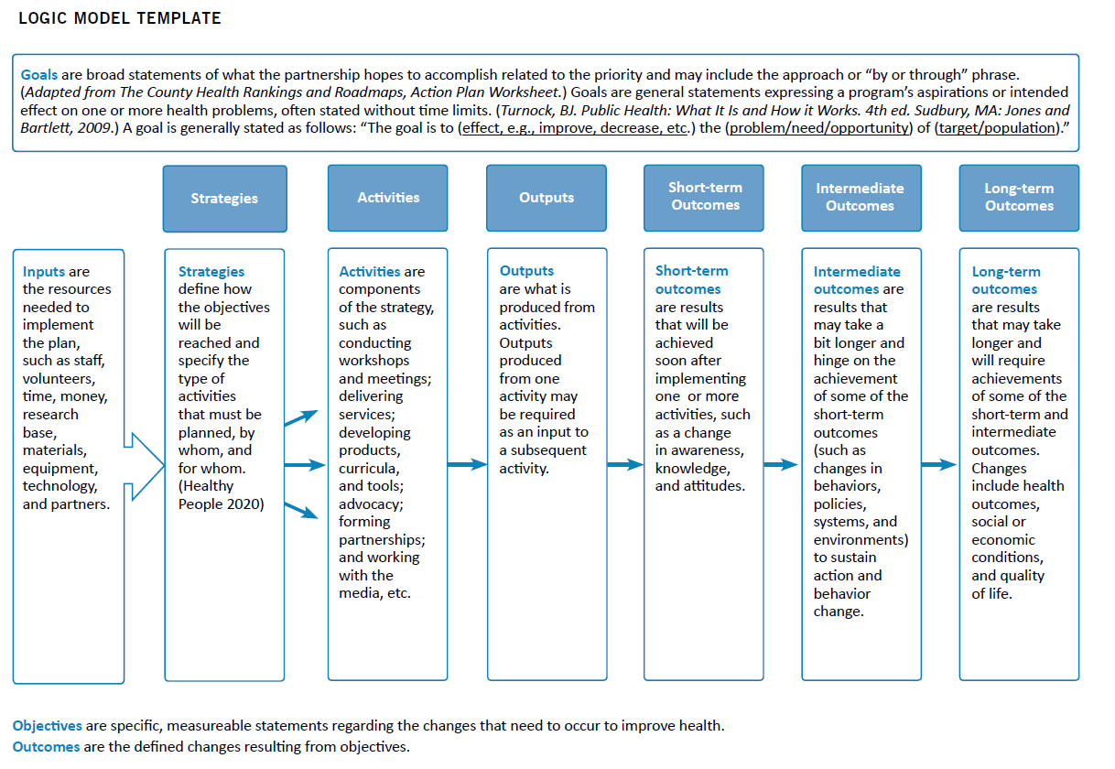
Step Three: Identify and Develop Health Indicators Through a Health Equity Lens
Logic models are a helpful tool to anchor and organize indicators and measures in a larger framework.
Notes:
Facilitation notes: Read content below.
Template source: Developing a State Health Improvement Plan: Guidance and Resources (astho.org)
Logic models are a helpful tool to anchor and organize indicators and measures in a larger framework. This slide provides an illustration of a logic model.
By making connections between inputs, activities, and outcomes, Island Areas can begin prioritizing indicators and data that help tell the equity story.
The Islands Health Equity Framework highlights existing and new indicators of health equity within an island context, all of which can be used to measure equity alone or in combination.
Consider replacing this example with a logic model created for a local program.

Slide 23
Step Three: Identify and Develop Health Indicators Through a Health Equity Lens
Examples of how to apply a health equity lens to existing health indicators
Indicator | Existing Measure | Data Source | Applying a Health Equity Lens
Foundational Conditions
Non-communicable disease | Diabetes prevalence in the population (based on either a self-report of having diabetes for which the patient is taking medication and/or an A1c measurement of 6.5% or higher) | NCD Hybrid Survey | Stratify rates of type 2 diabetes by geography (rural/urban, inner/outer islands), income level, social status, race/ethnicity, nationality, etc.
Societal Conditions
Employment | Percentage of the population employed for wages | NCD Hybrid Survey | Stratify employment status by age, sex, gender, education nationality, geography, mental health, etc.
Notes:
Facilitation notes: Read content below then briefly talk through the examples on the slide. Share other relevant examples as available.
This table is an example of existing/current measures that align with the Islands Health Equity Framework. It includes the data source and guidance on how to apply a health equity lens.
Starting from the left are indicators that reflect foundational conditions and societal conditions. In the next column are examples of existing measures from a specific data source. The last column provides ideas for how to apply a health equity lens by stratifying the data by geography, income level, social status, race/ethnicity, nationality, age, sex, gender, and more.
This process allows for a deeper understanding of how a public health issue or health condition is experienced or distributed within a community or population.

Slide 24
Step Three: Identify and Develop Health Indicators Through a Health Equity Lens
Examples of new health equity indicators that could be tailored to an island context.
Potential Indicator | Potential Measure
Foundational Conditions
Language | Percentage of patients receiving language services supported by qualified language services providers, stratified by [insert factor(s) here]
Institutional Influences
Healthcare and specialized services/ Public health services | Percentage of adolescents receiving depression screening, stratified by [insert factor(s) here]
 | Number of [insert sectors, departments, community-based organizations, hospitals, clinics, etc. here] participating in health equity initiatives each year
 | Public health-related social media reach, stratified by [insert subpopulations or priority populations here]
Notes:
Facilitation notes: Read the content below, then briefly talk through the examples on the slide. Ask the audience to share potential factors where indicated.
This table is an example of a potential (new) measure that aligns with the ASTHO Islands Health Equity Framework. You can still apply a health equity lens by deciding how to stratify each measure.
On the left are potential indicators, such as language, healthcare, and public health services. In the next column are potential measures that can be adapted to fit the local context or community. For example, which factors would be important to consider when stratifying the data to examine health equity, inequities, and disparities? Once again, this process helps deepen understanding of social and structural determinants of public health issues and which communities or populations are most affected.

Slide 25
Step Three: Identify and Develop Health Indicators Through a Health Equity Lens
Action Steps
Identify what is important to measure.
Select existing indicators and measures.
Develop new indicators and measures to fill gaps and address new areas of health equity.
Notes:
Facilitation notes: Read content below then read action steps on the slide content. Explore existing indicators and measure from local, available datasets. Where needed, develop new indicators and measures to fill in the gaps in the island/community context.
Developing new indicators and measures of health equity is complex and requires time, resources, and expertise in measurement., When determining health equity indicators and measures, consider the following steps in collaboration with public health agency staff, partners, and community members.
Action Steps
Identify what is important to measure.
Select existing indicators and measures.
Develop new indicators and measures to fill gaps and address new areas of health equity.

Slide 26
Step Four
Use Storytelling and Data to Achieve Health Equity
Notes:
Facilitation notes: Read content below. Use this step to use storytelling and data to achieve health equity.
Building on a shared understanding of health equity and how to apply a health equity lens to existing and new indicators, this step provides ideas for how to use storytelling and data to explore a public health issue or priority.

Slide 27
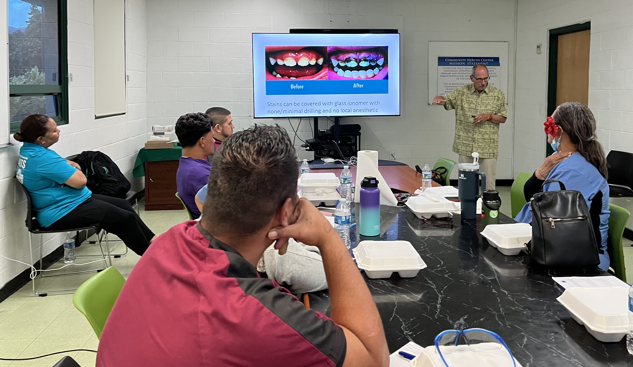
Step Four
There are multiple ways to pull together information, including infographics, brief data reports, and data profiles with selected indicators.
Storytelling is a culturally responsive and powerful way to communicate public health information with communities in island areas.
Notes:
Facilitation notes: Read slide content and then content below.
Stories are also a helpful tool when communicating public health data to diverse audiences.
Stories help connect people and are a way to share information or lessons learned in a simple way.
Measuring health equity often involves combining multiple indicators and stratifying data by groups and characteristics.
Having a simple way to organize indicators and data is an important step in using results to inform public health decisions.
It also provides a tool to engage community partners in helping public health agencies make sense of the results and play a role in creating solutions that advance health equity.

Slide 28
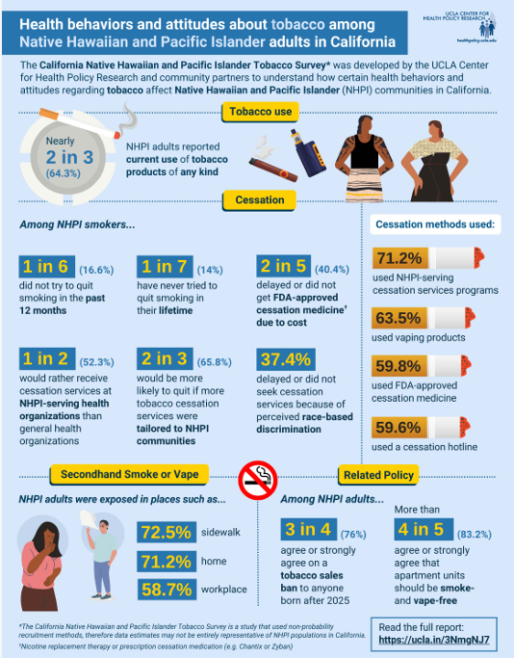
Step Four: Use Storytelling and Data to Achieve Health Equity
Consider how to engage the community within each of these steps:
Identify a public health issue or priority.
Review potential indicators and data sources to explore that issue.
Consider all the indicators you currently measure.
Stratify the data using a health equity lens.
Organize results in an infographic, brief data report, or data profiles.
Engage community partners in interpreting findings.
Use results to inform programs, practices, and policies within the public health agency, as well as the development of new health equity indicators.
Notes:
Facilitation notes: Read content below and the slide. Refer to the example infographic to highlight storytelling and/or share another island/community context.
Using storytelling and data to advance health equity involves conversations with multiple communities, organizations, and sectors; access to quality and timely data; and resources and skills to manage and analyze data.
Start small by using data to understand a key priority related to equity, and then scale over time by exploring other priorities.
Collaborating with community members and partners is essential when using storytelling and data to advance equity.
Consider how to engage the community within each of these steps:
Identify a public health issue or priority.
Review potential indicators and data sources to explore that issue.
Consider all the indicators you currently measure. From those indicators, identify a small set (two to four) to explore the issue (e.g., rates of depression among youth, geography, gender, age).
Stratify the data using a health equity lens.
Organize results in an infographic, brief data report, or data profiles. When possible, use stories to describe what you found and when sharing the results with community partners, organizations, and other sectors.
Be sure to engage community partners in interpreting findings. Ask questions about:
What story does this information tell? And what story do you want it to tell?
What information is missing from the story the data tells?
Whose stories are being told? Are there other populations who should be included in the future?
Are new health equity indicators needed to measure this public health issue moving forward?
Use results to inform programs, practices, and policies within the public health agency, as well as the development of new health equity indicators.

Slide 29
Step Five
Embed Health Equity Indicators into Plans
Notes:
Facilitation notes: Read the content below. Use this step to embed health equity indicators into plans.
Addressing health equity requires a long-term approach. Embedding health equity indicators into organizational plans helps ensure a long-term approach.

Slide 30

Step Five
It is important to look beyond the project and program level and incorporate health equity indicators into organizational and community plans.
Notes:
Facilitation notes: Read slide content and then content below. Pause between bullet points. Emphasize that a variety of plans can include health equity indicators. [Before the session add or replace plans your organization uses in the list below.]
Plans designed to support health equity can bolster focus and accountability and, at the same time, encourage integration across an organization’s divisions, departments, and/or programs, and community partners.
Applying a health equity lens to plans helps to institutionalize the efforts throughout the public health agency.
Potential plans include, but are not limited to:
strategic plans
community health improvement plans
quality improvement plans

Slide 31
Step Five: Embed Health Equity Indicators in Organizational Plans
Establish long-term vision and commitment.
  Engage public health agency staff, partners, and communities to revisit a shared understanding of health equity and community needs to identify opportunities to expand the scope of plans to address health equity.
    For example: Indicators and measures can be used to explore response and preparedness plans so they meet the needs of communities.
Incorporating health equity within the quality improvement structure.
  Use this as an opportunity to identify disparities and inequities in the context of quality improvement.
  Use indicators and measures to explore opportunities to tailor programs and services to meet the needs of the population of focus.
    Consider the following questions: What does the public health agency plan say? What monitoring is already being done at the program level?
Notes:
Facilitation notes: Read slide content. Pause between bullet points. Reflect on the content presented in orange and how it applies to the Island Areas Public Health Agency.
Establish long-term vision and commitment.
Engage public health agency staff, partners, and communities to revisit a shared understanding of health equity and community needs to identify opportunities to expand the scope of plans to address health equity.
2. Incorporating health equity within the quality improvement structure.
Use this as an opportunity to identify disparities and inequities in the context of quality improvement.
Use indicators and measures to explore opportunities to tailor programs and services to meet the needs of the population of focus.

Slide 32
Step Five: Embed Health Equity Indicators in Organizational Plans
3. Monitor the progress towards health equity indicators.
  Progress towards health equity indicators must be measured to improve outcomes and reduce inequities. Consider the following:
    Use health equity indicator data to demonstrate gaps in care by comparing a quality measure among two (or more) groups. For example: Colon cancer screening rates for migrant communities are compared with screening rates for community citizens.
    Develop dashboards for monitoring progress and reporting. Use the dashboard to assign individual tasks to public health agency staff. Ask yourself: What are we trying to accomplish? What are the manageable bite-sized tasks involved in implementing a change?
    Monitor progress on the health equity indicators and determine what actions will be taken to adjust to improve outcomes and reduce inequities. Ask yourself: Who is accountable for adjusting strategies to drive improvement as measured by indicators?
Notes:
Facilitation notes: Read the content on the slide. Refer to new and existing health indicators to explore opportunities to monitor progress toward health equity indicators.
3. Progress toward health equity indicators must be measured to improve outcomes and reduce inequities. Consider the following:
Use health equity indicator data to demonstrate gaps in care by comparing a quality measure among two (or more) groups. For example: Colon cancer screening rates for migrant communities are compared with screening rates for community citizens.
Develop dashboards for monitoring progress and reporting. Use the dashboard to assign individual tasks to public health agency staff. Ask yourself: What are we trying to accomplish? What are the manageable bite-sized tasks involved in implementing a change?
Monitor progress on the health equity indicators and determine what actions will be taken to adjust to improve outcomes and reduce inequities. Ask yourself: Who is accountable for adjusting strategies to drive improvement as measured by indicators?

Slide 33
Example
"We have a health equity program that is housed within the Office of Planning and Development that is addressing how the department defines and institutionalizes health equity. It starts at the strategic plan level because it is one of the identified priorities in the current strategic plan, but also how we operationalize that and continue to develop it."
Islands Areas Public Health Agency
An island area’s public health agency identified cancer as a leading cause of death through its vital statistics data. Based on this finding, the health agency included improving cervical cancer screening as part of its health improvement plan. When stratifying the screening data by age, the health department found that a lower percentage of women over the age of 30 received screening than those aged 30 and under, even though cervical cancer occurs most often in women over the age of 30. Therefore, the public health agency decided to focus its screening efforts on women over 30 years of age.
Example SMARTIE (Specific, Measurable, Attainable, Realistic, Time-Bound, Inclusive, and Equitable) Goal: Over the next five years, we will increase our cervical cancer screening rate for women over the age of 30 by 5% every year from 28% to 55%.
Notes:
Facilitation notes: Read the slide content and quote. Note this is an example how health equity indicators can be embedded into organizational plan. Share other local examples as available.

Slide 34
Step Six
Revisit and Scale Up Plans for Measuring Health Equity
Notes:
Facilitation notes: Read the content below. Use this step to revisit and scale up plans for measuring health equity.
Step 6 is revisiting and scaling up plans for measuring health equity. In this stage, the focus is on maintaining and building momentum.

Slide 35

Step Six
Revisiting and scaling up plans to measure health equity requires some flexibility as the issues will change over time.
Notes:
Facilitation notes: Read slide content and content below.
The way the issue was understood during the initial planning phases may no longer represent the reality in the community.
It is important to continually engage with the community. Regularly reviewing goals and strategies with key partners ensures that the initiatives remain relevant and responsive to the community.

Slide 36
Step Six: Revisiting and Scaling Up Plans for Measuring Health Equity
Consider challenges in measuring health equity.
  When revisiting and scaling up plans, it is important to consider the challenges identified in Measuring Health Equity: An assessment of equity metrics in performance management and planning – namely workforce capacity and data limitations.
    Increasing Workforce Capacity: Seek out resources, tools, and training to enhance the skills of the workforce.
    Decreasing Data Limitations: Identify data gaps in measuring health equity and including lacking data points on health assessments will inform subsequent health equity efforts.
Notes:
Facilitation notes: Read slide content and content below. Refer to the Measuring Health Equity resource as you consider challenges in measuring health equity.
Increasing Workforce Capacity:
Seek out resources, tools, and training to enhance the skills of the workforce will bolster the efforts to incorporate health equity into all aspects of grant-related work, from development to monitoring.
Decreasing Data Limitations:
Collect these data points allows for a more robust analysis of factors affecting health equity.
Findings from the robust analysis should inform project planning and drive objectives and activities that directly respond to any inequities identified.

Slide 37
Step Six: Revisiting and Scaling Up Plans for Measuring Health Equity
2. Revisit and scale up health equity efforts. Consider the following:
  Continually engage with the community to identify additional priorities or public health issues.
  Increase the workforce’s skills to incorporate health equity into their work, from program planning, design, and implementation to monitoring and evaluation. Train staff on how to use data to measure progress on health equity.
  Identify gaps and consider new data collection methods for identifying root causes and key drivers of inequities.
  Utilize root cause and key driver data findings to inform public health practice.
Notes:
Facilitation notes: Read slide content. Reflect on efforts to revisit and scale up plans to measure health equity.

Slide 38

Conclusion
By utilizing these steps, we can begin to understand and apply health equity metrics to help understand issues impacting communities, monitor progress on efforts, and identify opportunities for improvement.
Notes:
Facilitation notes: Read slide content. Open for questions and discussion.

